Slide 1



Dinuka Ravijaya Piyadigama
2018373 | w17421047/2
NFT-RecSys
A Trading Recommendations System for Non-fungible Tokens

Slide 2
Agenda
Page
Problem
Research Gap
Aim of the Project
System Design
Implementation
Demo
Testing & Evaluation
Evaluators
Limitations & Future Enhancements
Conclusion
3
4
6
7
8
9
10
12
15
16

Slide 3
Problem
NFTs
Provably scarce unique digital assets
Ownership represented by Blockchain
The biggest thing of 2021
Digital artworks have been the center-stage
NFT Market
OpenSea - Amazon of NFTs
Jan 2022 - monthly trading volume > $3.5 Billion
2021 - $41 Billion valuation
2026 - expected market valuation > $147 Billion
(Locke, 2022)
(Parashar, 2022)
Background
(Non-fungible Token (NFT) Market by Application and Geography - Forecast and Analysis 2022-2026, 2022)
Recommendation Systems
Driving engagement & consumption of content & items on every corner of the internet for the last decade
Reduces information overload
35% of Amazon's revenue
60% of Youtube watch time
(Naumov et al., 2019)
(Recommendations 2021)
Problem
No Recommendation System for NFT item recommendations
Difficulty in finding/ recommending relevant, trending, timely items.
Notes:
NFTs - one of a kind
Blockchain technology is used to represent the ownership of the assets

Slide 4
Research Gap - Technical
Collaborative Filtering (the standard technique for the last decade) - can't be taken as the only model
by the time one NFT is viewed many times by other users, it may already be too late for another user to purchase that item.
Amazon identified that people prefer to watch recently released movies over highly rated, old ones
(Larry, 2019)
No previous research related to NFTs

Slide 5
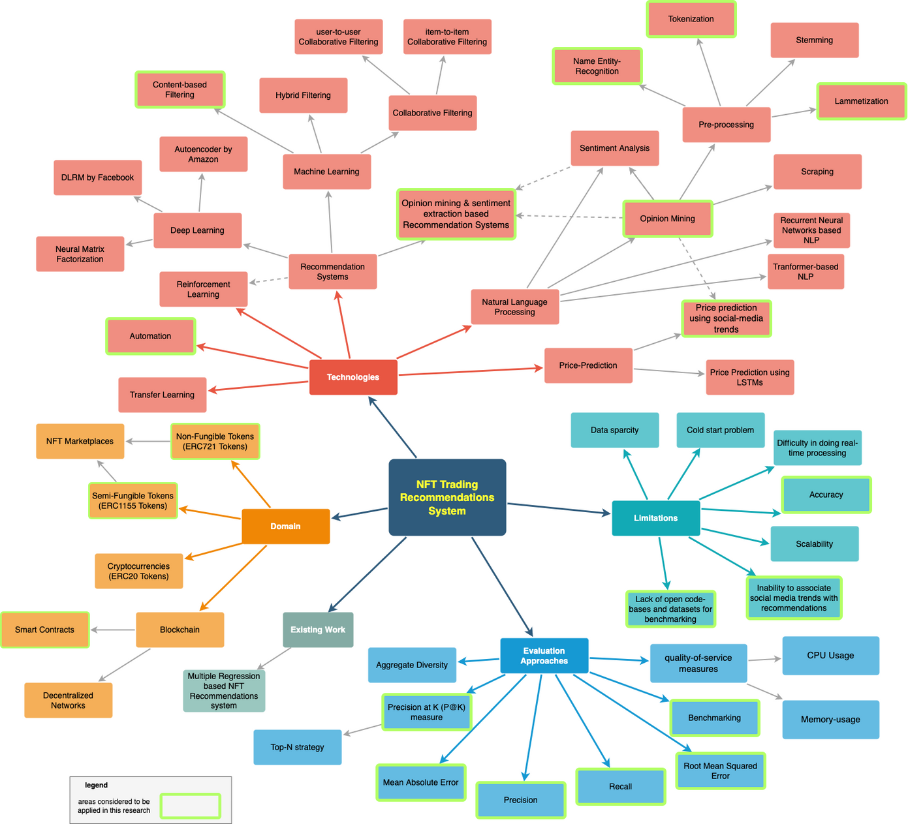
Research Gap

Slide 6
Aim of the Project
Design, develop & evaluate a novel Recommendations Architecture that will provide relevant, trending, timely, and worthy NFTs for trading purposes by automating some of the decision-making steps that the user would otherwise have to do manually.

Slide 7
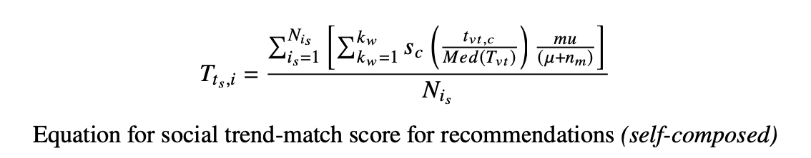
System Design
Trends-based RecSys - Algorithm
trend-score for one item
sentiment score
Tweet volume
matched bool
user priority
median Tweet volume
number of days since the trend
μ - constant, set to 0.1 to avoid division by 0 error for today's trends
kw - number of keywords in the current item
𝑁𝑖𝑠 - total number of information sources

Slide 8
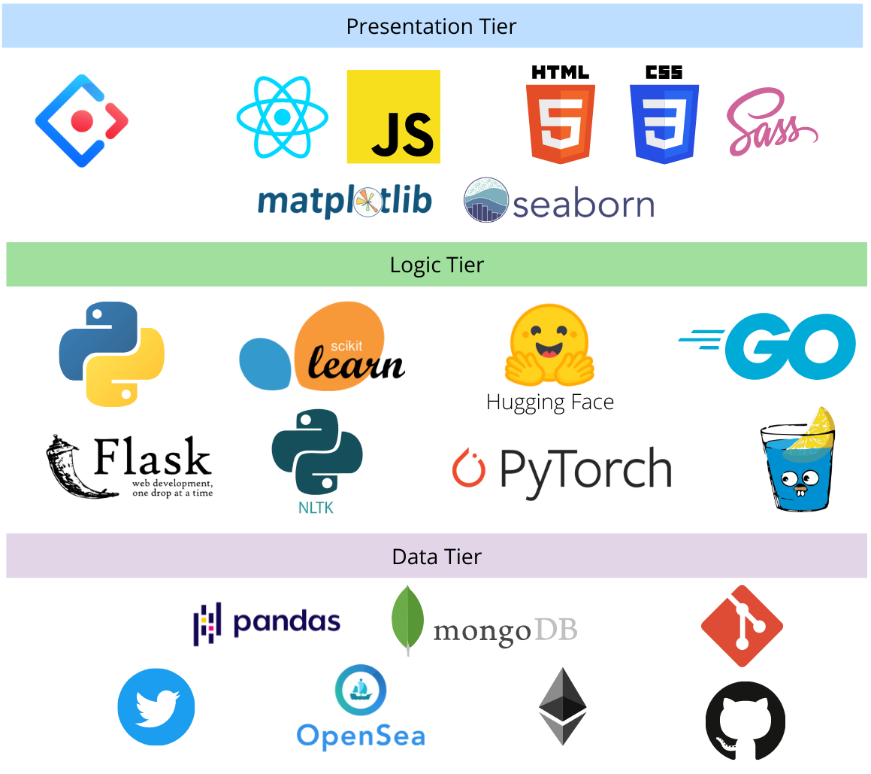
Implementation

Slide 9

Demo

Slide 10
Testing & Evaluation
Trait Similarity & Rarity based RecSys
Similarity-based
Rarity-based
reference item
Similarity-based
Rarity-based
reference item
1
400
0.75
300
0.5
200
0.25
100
0
0
0
5
NFT Item
10
15
0
5
NFT Item
10
15

Slide 11
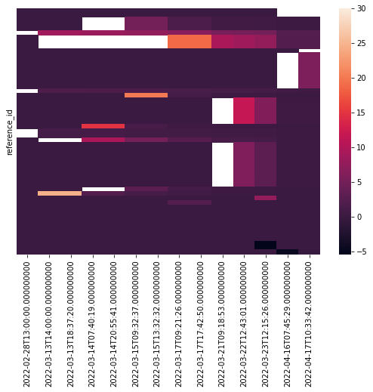
Testing & Evaluation
Trends-based RecSys
total matches
new matches
20
15
10
5
0
2022-02-28T13:00:00
2022-03-13T14:00:00
2022-03-14T20:55:41
2022-03-17T09:21:26
2022-03-17T17:42:50
2022-03-21T09:18:53
2022-03-22T12:43:01
2022-03-23T12:15:26
2022-04-16T07:45:29
2022-04-17T10:33:42

Slide 12
Evaluators
Name | Professional Occupation | Highest Academic Qualification
Prof. Narada Warakagoda | Principal Scientist at FFI/ Associate Professor at University of Oslo | PhD in Signal Processing/ Speech Recognition (Norway)
Upali Kohomban | Head of Research - Codegen (UK) | PhD in Computer Science - NUS (Singapore)
Dr. Akshika Wijesundara | Senior Technical Lead - Data Scientist (Growth) at WSO2, Founder & Chairperson of SEF | PhD in Computer Science - The Open University (UK)
Dr. Kaneeka Vidanage | Head Of Research - OREL IT | PhD in Artificial Intelligence (Malaysia)
Ms. Gayani Nanayakkara | Academic Tutor & Research Assistant | PhD in Artificial Intelligence (Reading) - Robert Gordon University (Scotland)
Mr. Sharmilan Somasundaram | CEO of Niftron | Certified Blockchain Solution Architect (CBSA), MSc Big Data Analytics
Mr. Narada Wickramage | Assistant Director - MIS & Statistics, Public Utilities Commission of Sri Lanka | MSc, MBA
Mr. Aadhil Rushdy | Senior Data Engineer/Team Lead - Sysco Labs | MSc Computer Science - specialized in Data Science Engineering & Analytics (University of Moratuwa)
Mr. Jajeththanan Sabapathipillai | Chief Product Officer - Niftron | BE (Hons) Computer Software Engineering
Mr. Sasila Hapuarachchi | Incoming Engineer - Amazon (Canada) | BE Electrical Engineering (Co-op) (Canada)

Slide 13
Evaluators
Name | Professional Occupation | Highest Academic Qualification
Mr. Nipuna Senanayake | Senior Lecturer - IIT | MS Computer Science (USA)
Mr. Achala Aponso | Senior Lecturer - IIT | MSc Artificial Intelligence
Mr. Prasan Yapa | Level 2 Coordinator - BSc (Hons) in Artificial Intelligence & Data Science Program, Lecturer - Software Engineering - IIT | MSc (Major Component in Research) in CS
Anonymous | Lecturer | Blockchain Masters Researcher
Ms. Areefa Thassim | Software Engineer - MillenniumIT ESP | MSc Big Data Analytics
Anonymous | Data Engineer | BEng (Hons) Software Engineering
Lasal Jayawardena | - | Undergraduate - BSc (Hons) Artificial Intelligence and Data Science
Nazhim Kalam | Software Engineering Trainee - 99x | Undergraduate - BSc (Hons) Computer Science
Ammar Raneez | Trainee Software Engineer - 99x | Undergraduate - BSc (Hons) Computer Science
Gibran Kasif | Trainee Software Engineer - Vestoria | Undergraduate - BSc (Hons) Computer Science

Slide 14
Evaluators' Evaluation Highlights
"highly technical core problem that is addressed, which is a complex one on its own even as a theoretically modeled one.
the problem itself is intriguing and quite relevant as an interesting problem.
The level of details covered in the thesis on the software aspects is exceptionally good and well thought out.
decisions made on the architectural aspects, such as building the components in a microservices architecture, are in line with the matured industry standards, but not common to see in undergraduate-level work.
the problem addressed, and the solution proposed is interesting, and the work carried out is ambitious."
Dr. Upali Kohomban, Head of Research - Codegen (UK)
PhD in Computer Science - NUS (Singapore)
"The researcher has implemented and evaluated recommendation systems suitable for NFTs, and hence contributed with novel results. The research work carried out is impressive."
Prof. Narada Warakagoda, Principal Scientist at FFI/ Associate Professor at University of Oslo
PhD in Signal Processing/ Speech Recognition (Norway)

Slide 15
Limitations & Future Enhancements
Build a price-prediction model for NFTs
Difficult due to the uniqueness of NFTs, lack of data
Try using a dataset of rare-physical artwork
The trends-based model is only effective if accurate, diverse descriptions are provided for NFTs.
Currently, only Twitter trends are used
Source trends from multiple platforms (Reddit, Discord, Google, private forums)
Create a decentralized Recommendations Eco-system using the Trends-based RecSys
Extends NLP preprocessing
Pre-process & separate hashtags in trends
As a substitute for recently released movies, integrate trends to bolster recommendations
Due to the lack of data and open code bases, this couldn't be attempted
Extend the trends-based recommendations to personalized recommendations
trends could be categorized for this purpose
would be almost impossible to implement without collecting user-specific data.

Slide 16
Conclusion - Contributions
Technical Contribution (Recommendations Systems)
Social Trends influenced Recommendation Model - a novel, innovative concept & approach taken
Trends-score calculation equation & algorithm
Domain Contribution (NFTs)
Identification & Analysis of factors that can be used to produce NFT item recommendations.
Additional Contributions
Data Preprocessing scripts
Social media trends extraction
NFT Data extraction
Trait rarity calculation
NFT Asset datasets - made available on Kaggle
Created a Latex template for the expected thesis structure that can be used by IIT students in the future
(Contributions made by Visal Rajapakse, Isala Piyarisi & Akassharjun Shanmugarajah).
Publications - all have been published as preprints on ArXiv
Exploration of the possibility of infusing social media trends into generating NFT recommendations.
An Analysis of the Features Considerable for NFT Recommendations.
A Review on Pushing the Limits of Baseline Recommendation Systems with the integration of Opinion Mining & Information Retrieval Techniques.

Slide 17

Conclusion - Skills
Existing Skills
Acquired Skills
Fullstack R&D
Golang
Recommendation
Systems
NLP
Blockchain
Data Engineering
Data Mining
Information Retrieval
Machine Learning Deep Learning
Python - Pandas
Notes:
Fullstack R&D - Zone24x7 Internship + Inforwaves
Blockchain - Blockchain Research Group of IIT with 99x + Niftron
Latex

Slide 18
Summary
Inception of research related to NFTs
Pre-processed NFT datasets made available on Kaggle
Novel Algorithm & Architecture to produce
Social Trends based Recommendations
2 Research Papers
1 Review Paper
4 Recommendation Models
Use of Latex for Documentation
NFT-RecSys
Identification of features that can be used for NFT Recommendations
Latex Template that can be used by future students of IIT
20
Evaluations

Slide 19
Dinuka Ravijaya Piyadigama
2018373 | w17421047/2
Thank you
for listening!

Slide 20
References
Larry, Hardesty (Nov. 22, 2019). The history of Amazon’s recommendation algorithm. Amazon Science. Section: Latest news. url: https://www.amazon.science/the-history- of-amazons-recommendation-algorithm (visited on 05/25/2021).
Naumov, Maxim et al. (May 31, 2019). “Deep Learning Recommendation Model for Personalization and Recommendation Systems”. In: arXiv:1906.00091 [cs]. arXiv: 1906.00091. url: http://arxiv.org/abs/1906.00091 (visited on 04/29/2021).
Recommendations (2021). Recommendations: What and Why? | Recommendation Systems. url: https://developers.google.com/machine-learning/recommendation/ overview (visited on 08/24/2021).
Locke, T., 2022. The NFT market is probably not as down as you think it is. [online] Fortune. Available at: <https://fortune.com/2022/05/05/nft-market-sales-not-flatlining-data-shows/> [Accessed 16 May 2022].
Technavio. 2022. Non-fungible Token (NFT) Market by Application and Geography - Forecast and Analysis 2022-2026. [online] Available at: <https://www.technavio.com/report/non-fungible-token-nft-market-industry-analysis> [Accessed 16 May 2022].
Parashar, R., 2022. OpenSea Sets New All-Time High of $3.5 Billion in Monthly NFT Sales. [online] NDTV Gadgets 360. Available at: <https://gadgets360.com/cryptocurrency/news/opensea-nft-marketplace-trade-volume-usd-3-5-billion-all-time-high-2714138> [Accessed 16 April 2022].

Slide 21
A New way of looking at Recommendations
User Click Data per day
Trends Data for 15 days
8 GB
136KB
58,823.5 X
Less Storage
Notes:
No Recommendation systems in SL e-commerce sites

Slide 22
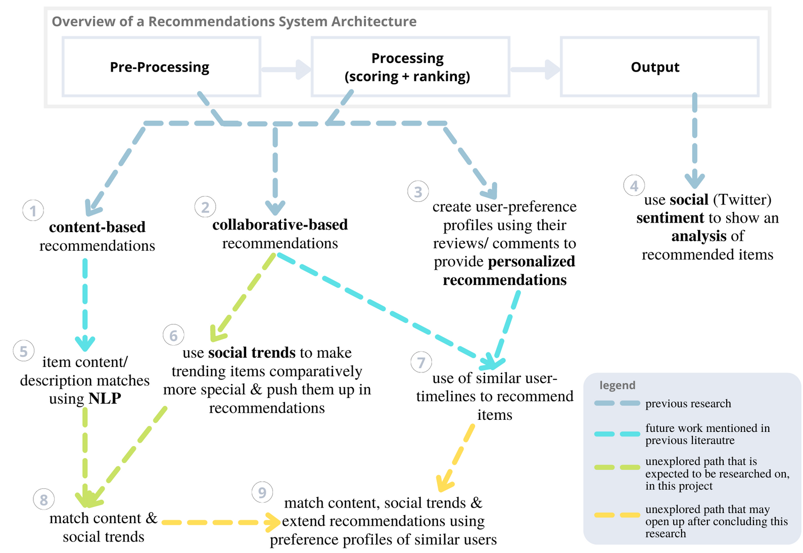
Research Gap

Slide 23
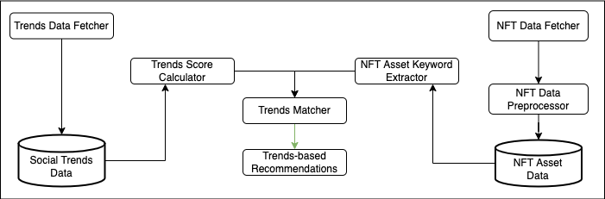
System Design
Trends-based RecSys - Process

Slide 24
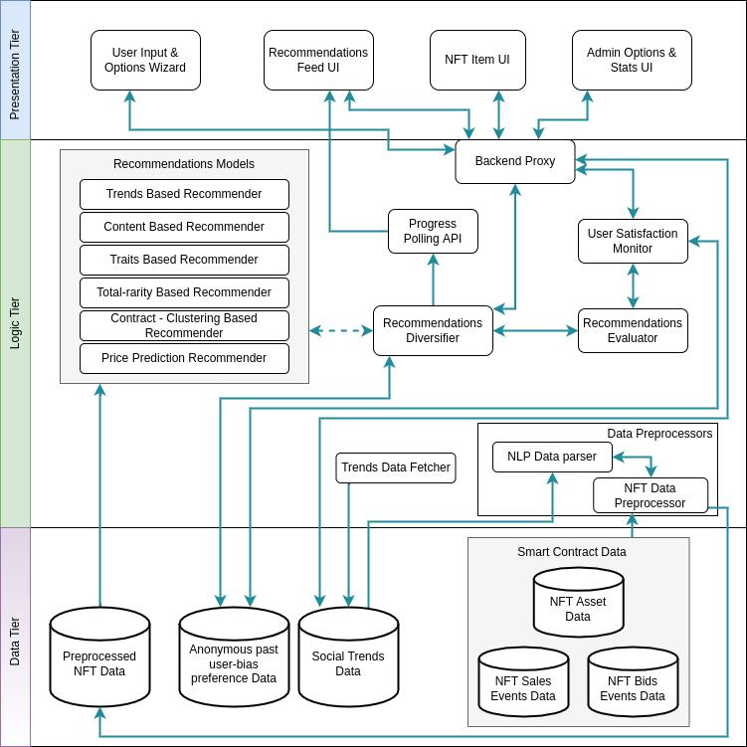
System Design - Architecture

Slide 25
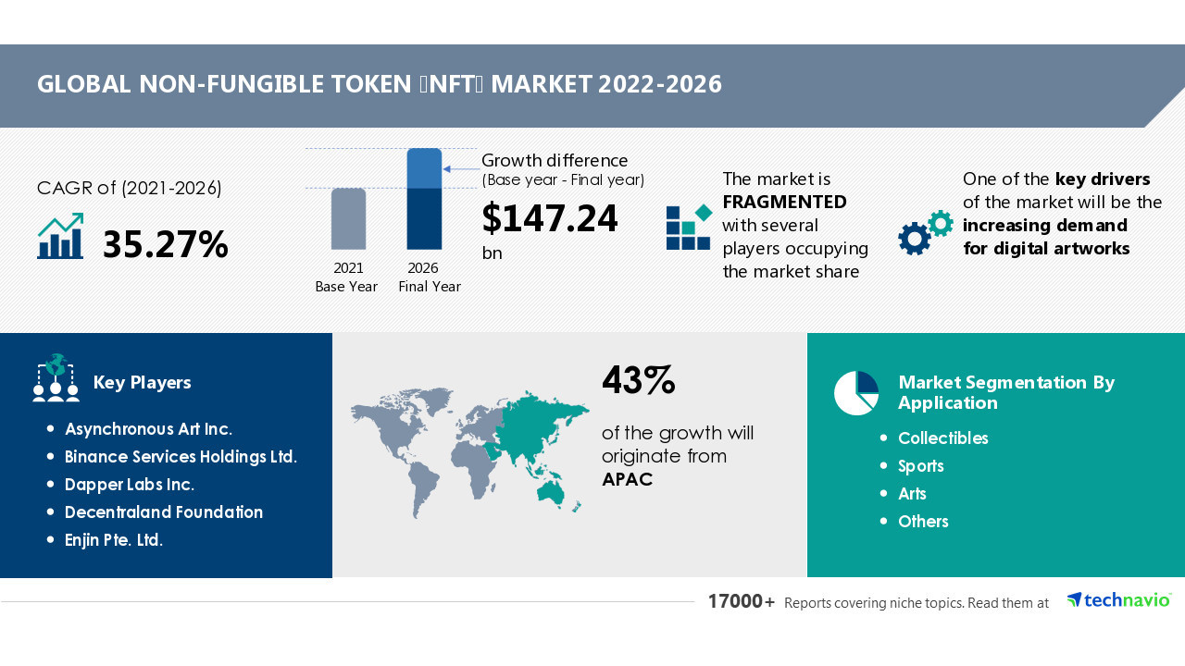
Growth of NFT market

Slide 26
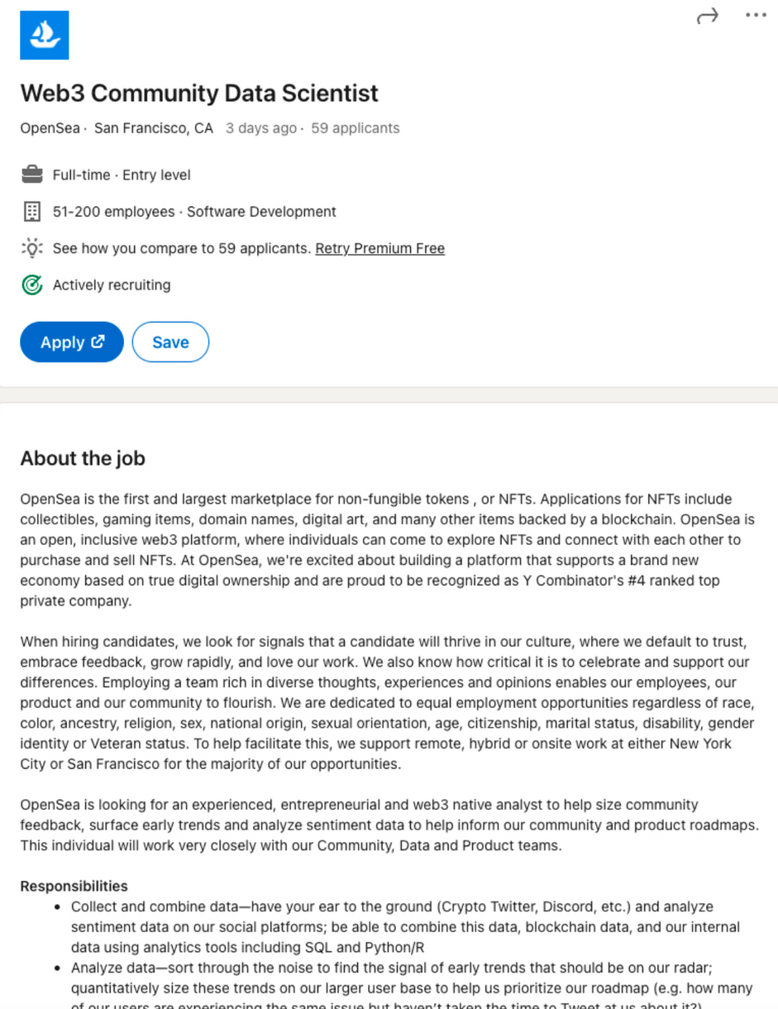
OpenSea - Job Req

